Slide 1

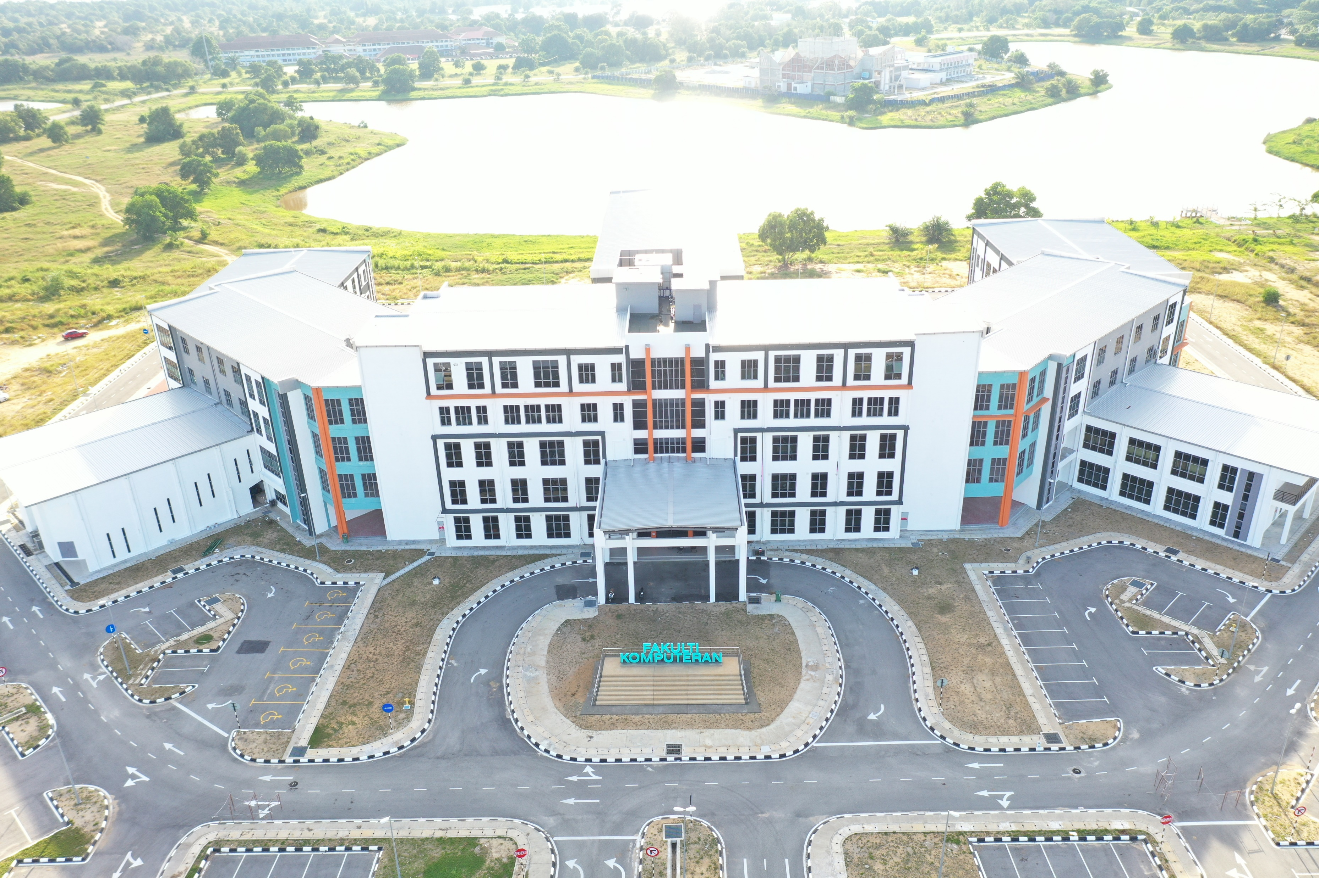



LECTURE NOTE
ARTIFICIAL INTELLIGENCE
Topic: Basic Knowledge Representation
and Reasoning (Part 1)
DR ANIS FARIHAN MAT RAFFEI
OER Artificial Intelligence by Anis Farihan Mat Raffei
work is under licensed Creative Commons Attribution-
NonCommercial-NoDerivatives 4.0 International License

Slide 2
OUTLINES
Knowledge Discovery in Database (KDD)
Overview of Case-Based Reasoning (CBR)
CBR Architecture and System
2

Slide 3
EXPECTED OUTCOMES
Expected Outcomes
Be able to understand all processes involved in knowledge discovery database
Be able to understand the case-based reasoning definition and components
Be able to understand the architecture of case-based reasoning as well as computation involved
3

Slide 4
Knowledge Discovery in Database (KDD)
Background of KDD
KDD Process
4

Slide 5
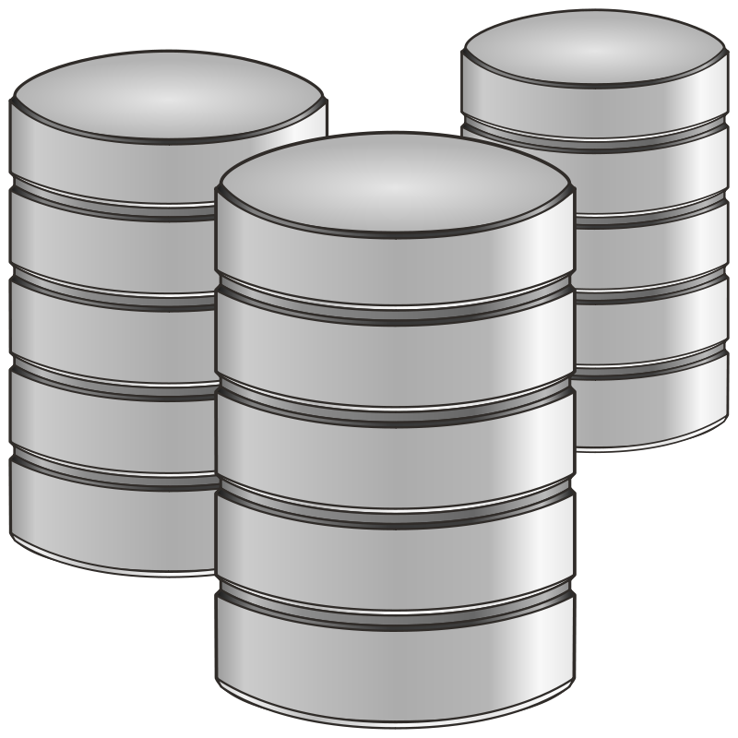

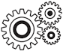
Background of KDD
Definition: Refers to the broad process of finding knowledge from data in the context of large databases
Aim: To extract or discover knowledge in large and complex data
Large and complex data
Finding / Extracting Knowledge Process
Knowledge
5

Slide 6
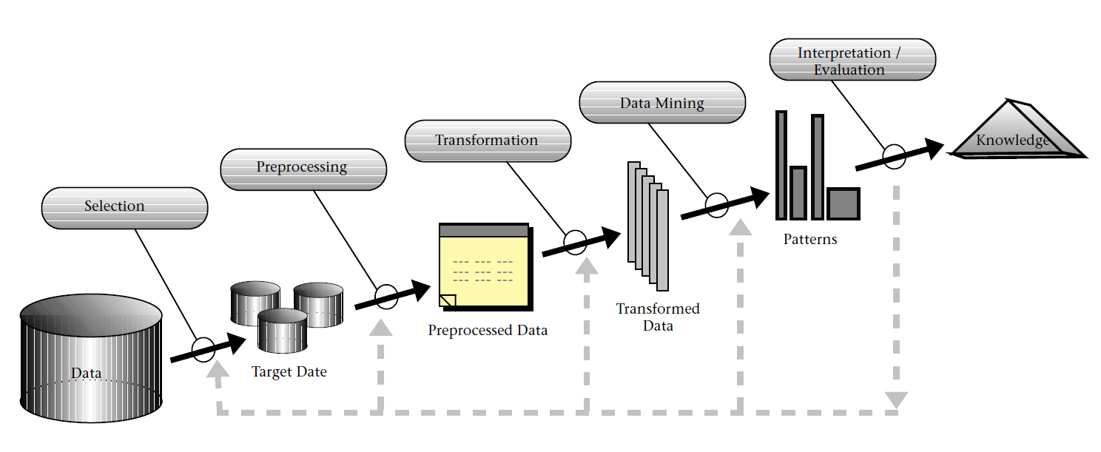
KDD Process
Source: Fayyad et al. (1996)
6

Slide 7
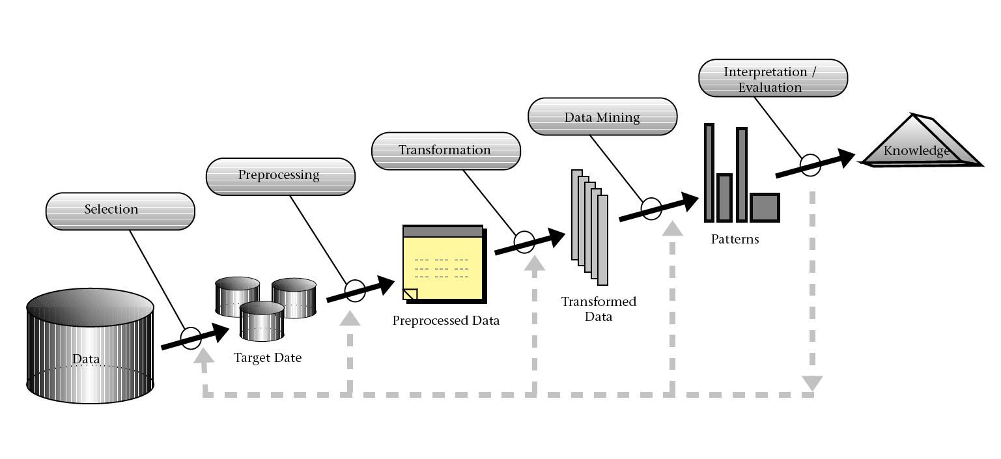
KDD Process- Selection
Refers to the process of obtaining data for data mining process.
The data may come from different and heterogeneous data sources.
The data need to be selected before it can be an input for the data mining process.
This steps is important in order to select only significant data that will be used for the entire study
Before performing this step, it is important to understand the application domain and the relevant prior knowledge as well as identifying the goal of the KDD process.
Target Data
Source: Fayyad et al. (1996)
7

Slide 8
KDD Process- Preprocessing
Once the target data has been determined, the raw data need to go through a data cleaning process.
This process treats the raw data into good and healthy data to fit into the classification process
Processes include replacing a missing data, correcting the noisy data and eliminating the unwanted attribute to ensure the classification process run smoothly and obtain a good quality result.
Target Data
Source: Fayyad et al. (1996)
8

Slide 9
KDD Process- Transformation
Target Data
Source: Fayyad et al. (1996)
Also known as data reduction and projection
The aim for data transformation is quite similar to data pre-processing, that is to pledge a good input for the classification process.
This process involves converting or transforming the data into usable format.
Data from previous process (pre-processing) may be modified to facilitate usage by the selecting technique that requires specific data format. Some attributes values may be combined to produce new value; data reduction or converting data from discrete value to continuous value, or vice-versa.
9

Slide 10
KDD Process- Data Mining
Target Data
Source: Fayyad et al. (1996)
The most important step in the KDD process.
The literal definition of data mining is “to uncover useful information from a large amount of data.”
The purpose of data mining is to extract interesting knowledge from a database, data warehouse, or some other large information storage unit.
This step apply suitable algorithms to transform data into desired results.
10

Slide 11
KDD Process- Interpretation/Evaluation
Target Data
Source: Fayyad et al. (1996)
This stage conveys the data mining result into understandable format to be used by users.
Discovered pattern must be clearly interpreted and evaluated to ensure the resulting information is clear and express the result straight to the end user without any misunderstanding.
The discovered knowledge is then incorporating the knowledge into another system for further action including checking for any potential conflicts with previous knowledge.
11

Slide 12
Overview of Case-Based Reasoning (CBR)
What is CBR?
Types of case organisation
Components in CBR
12

Slide 13
What is CBR?
Case- An experience of a solved problem.
Based- The reasoning is based on cases, that is, cases are the first source for reasoning
Reasoning- The approach is intended to draw conclusions using cases, given a problem to be solved
Definition:
Using old experiences to understand and solve new problems (Kolodner, 1992)
Solves new problem by using or adapting that were used to solve old problems (www.ai-cbr.org)
An Artificial Intelligence (AI) technique that imitates how human make a decision. In CBR, new problems are solved by recalling from previous solved problems which are stored in the case-base (Aamodt and Plaza, 1994)
In a nutshell:
CBR is an AI technique that try to model or imitate human reasoning (decision making) and thinking
One of a method for building intelligent computer systems
It is a supervise learning algorithm which classes are determine before examining the data
The input pattern is classified into one or several classes based on similarity to the predefine classes
Cases are stored in the “case-base”
13

Slide 14
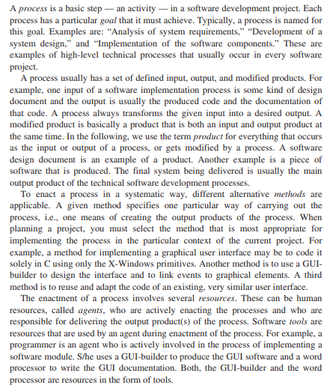
Types of case organisation
Case
Structured
Unstructured
Beneficial when the number of cases is very large
Cases are very commonly hidden within texts /images
Flat
Most suitable for a small number of cases
Source: https://www.researchgate.net/publication/255171639
14

Slide 15
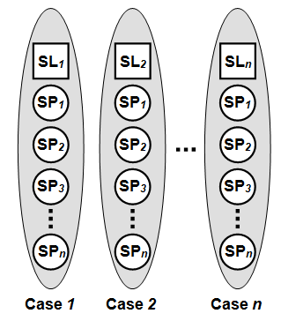
Components in CBR
A case describe one particular diagnostic situation
Collection of cases are call “CASE-BASE”
Case(s) have two main components:
Specification (SP): set of attributes (features) and values – represent particular case or problem and it should have unique characteristic.
Solution (SL): the case solution, represent the problem solving for such case.
Source: Fayyad et al. (1996)
15

Slide 16
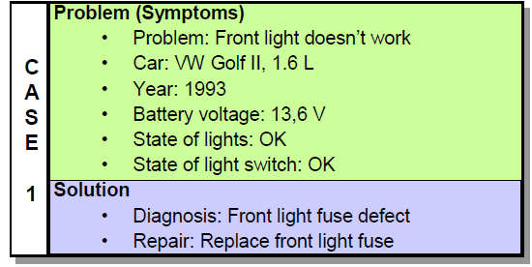
Components in CBR
Example: Car diagnostic situation
Attribute
Value
Source: https://courses.csail.mit.edu/6.871/lectures06/Lect17CBR.pdf
Decision
16

Slide 17
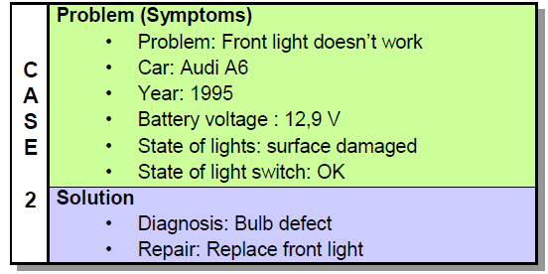
Components in CBR
Example case-base flat: Car diagnostic situation
Case-base with two cases
Each case describe one particular situation
All cases are unique from each other
Source: https://courses.csail.mit.edu/6.871/lectures06/Lect17CBR.pdf
17

Slide 18
Components in CBR
Example case-base structured: Gate Opening Kuantan Dam
Attributes | Case ID | Case ID
Attributes | Case 1 | Case 2 | Case 3 | Case 4
Dam water level | 29.26 | 28.99 | 29.50 | 27.01
Sg. Pahang | 11.06 | 13.09 | 12.89 | 10.11
Sg. Soi | 30.40 | 29.01 | 20.99 | 27.89
Sg. Pekan | 15.99 | 17.09 | 21.99 | 11.09
Sg. Gambang | 23.00 | 20.99 | 21.09 | 19.22
Gate | Open | Close | Close | Open
18

Slide 19
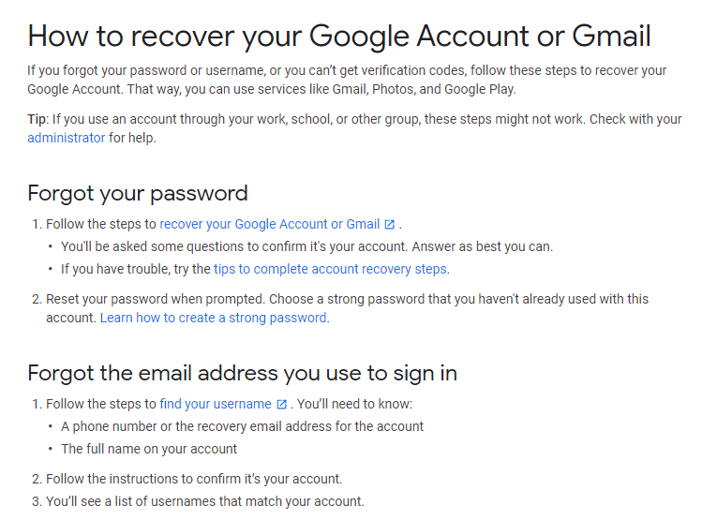
Components in CBR
Example case-base unstructured: Google Frequently Asked Questions
Source: https://support.google.com/accounts/answer/7682439?hl=en
19

Slide 20
CBR Architecture and System
CBR Cycle
How to find solution?
Similarity Computation
Example Case-Car diagnostic
20

Slide 21
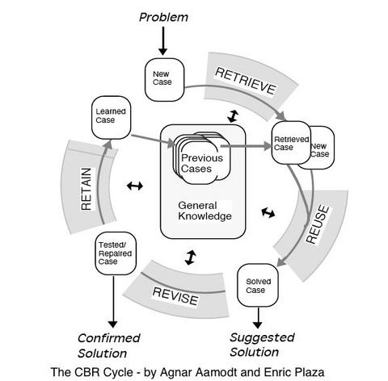
CBR Cycle
Retrieve- Find similar problems
Reuse- Propose solutions from retrieved cases
Revise- Adapt and repair proposed solution
Retain- Integrate in case-base
Source: Aamodt and Plaza (1994)
21

Slide 22
CBR Cycle- Retrieve
What is Case Retrieval?
Usually regarded as the most important in CBR cycle
Various approach have been developed to retrieve similar cases in CBR
Similarity measure are used in the CBR retrieval process
Poor reasoning resulted from poor similarity measure
22

Slide 23
CBR Cycle- Retrieve (Conti….)
What is Similarity measure?
Used in problem solving and reasoning to match a previous experience/case (case-base) with the new unseen problem to find solution
Can be call as case matching in CBR- match new case with the previous cases from the case-base to find solution
It is the heart of CBR system!
Purpose of similarity:
Select cases that can be adapted easily to the current problem
Select cases that have (nearly) the same solution than the current problem
Basic assumption: similar problems have similar solutions
Goal of similarity modeling: provide a good approximation
23

Slide 24
CBR Cycle- Retrieve (Conti….)
Two types of Similarity:
Local Similarity (LS)
Used to compute the similarity between query (new problem) and case attributes values – feature level
Global Similarity (GL)
is a build up from number of local similarity function. It is a weight sum of the local similarity – case/object level
The similarity measurement for local similarity is calculate between each attribute values, while Global Similarities is calculated between each cases.
Relationship between Local (SL) & Global Similarities :
Global Similarity
LS 2
LS 3
LS 1
LS 4
LS n
24

Slide 25
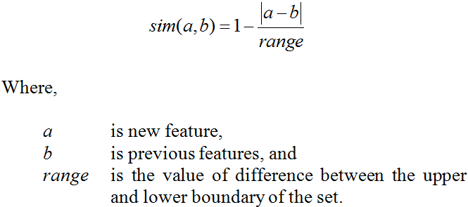
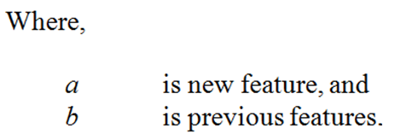
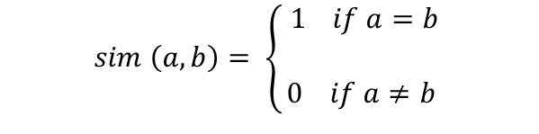
CBR Cycle- Retrieve (Conti….)
Local Similarity:
Similarity between two cases is based on local similarity between each case attributes values (feature)
There are two type of local similarity formula:-
Numerical/Continuous value
Discrete value
$$sim \left(a,b\right)= \left\{\begin{aligned} 1 if a=b \\ \\ 0 if a≠b \end{aligned}\right.$$
25

Slide 26
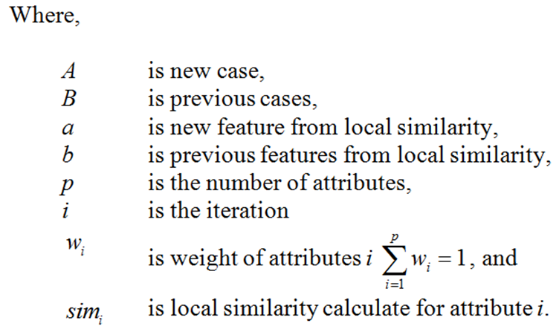
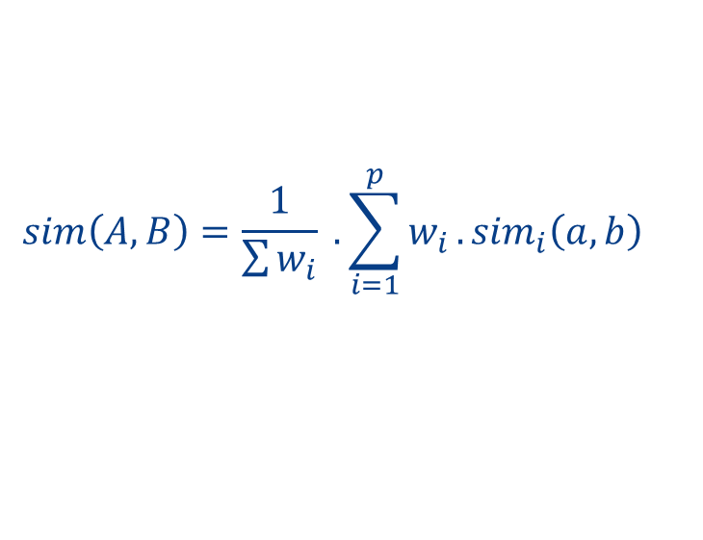
CBR Cycle- Retrieve (Conti….)
Global Similarity:
After a set of local similarities have been calculated for each feature in the case, a global similarity will be calculated.
Global similarity provides a case-matching behavior using the global similarity calculation to find the relationship between two cases.
$$sim\left(A,B\right)=\frac{1}{\sum{w_{i}}} . \sum_{i=1}^{p}{w_{i}}.{sim}_{i}\left(a,b\right)$$
26

Slide 27
CBR Cycle- Reuse
The use of case is a reuse of previous experiences/solution in a new problem/situation.
How to Adapt the Solution?
Different options available:
No modification of the solution: just copy
Manual/interactive solution adaptation by the user
Automatic solution adaptation
Transformational Analogy: transformation of the solution
Derivational Analogy: replay of the problem-solving trace
Compositional adaptation: combine several cases to a single solution
27

Slide 28
CBR Cycle- Revise
Verification & Correct Solution
Revise phase
No revise phase
Verification of the solution by computer simulation
Verification / evaluation of the solution in the real world
Criteria for revision
Correctness of the solution
Quality of the solution
Other, e.g., user preferences
28

Slide 29
CBR Cycle- Retain
Learning from solve problem:
What can be learned:
New experience (new case)
Improved similarity assessment, importance of features
Organization/indexing of the case base to improve efficiency
Knowledge for solution adaptation
Forgetting cases, e.g., for efficiency or because out-of-date
Methods:
Storing cases in the case-base
Deleting cases from the case-base
29

Slide 30
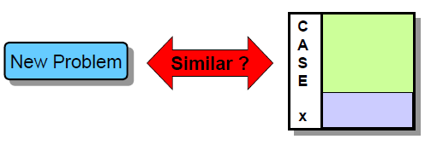
How to find solution?
Rank the cases according their similarities
Similarities is the most important concept in CBR
We can assess similarity based on the similarity of each attributes (features)
Similarity of each attributes (features) depends on the attribute's VALUE
30

Slide 31
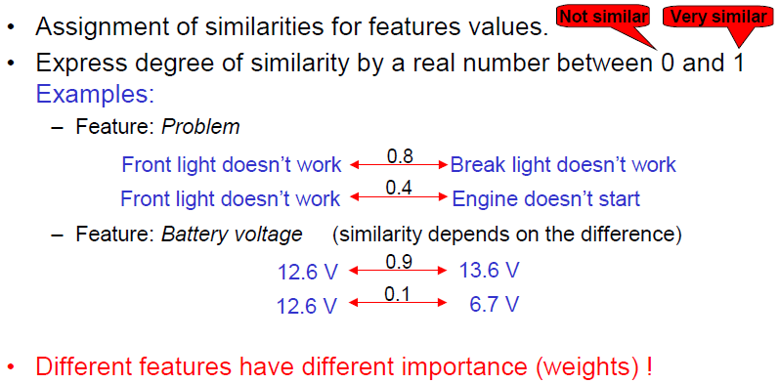
Similarity Computation
31

Slide 32
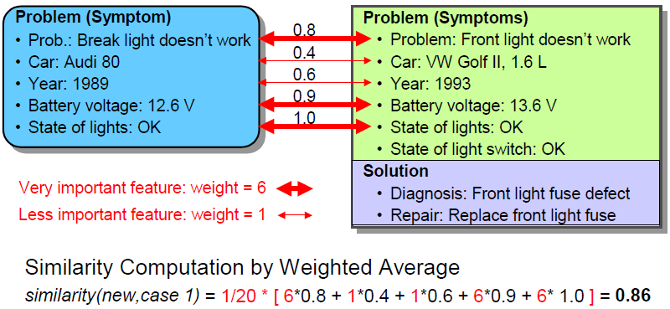
Example Case-Car diagnostic
RETRIEVE: Compare a new problem to CASE 1
Source: https://courses.csail.mit.edu/6.871/lectures06/Lect17CBR.pdf
32

Slide 33
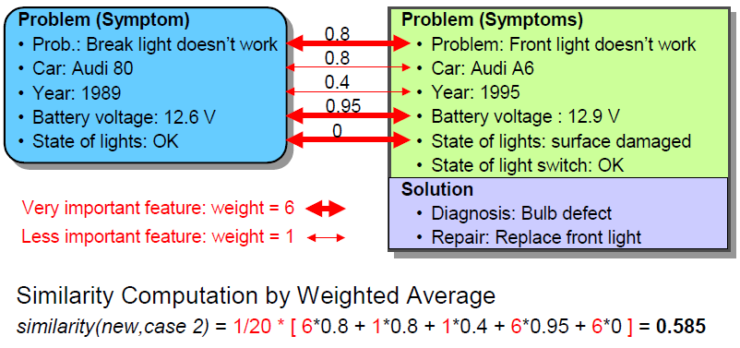
Example Case-Car diagnostic (Conti…)
RETRIEVE: Compare a new problem to CASE 2
Source: https://courses.csail.mit.edu/6.871/lectures06/Lect17CBR.pdf
33

Slide 34
Example Case-Car diagnostic (Conti…)
So the Solution?
New problem similar to Case 1 = 0.86
New problem similar to Case 2 = 0.585
Case 1 is more similar to the new problem!
Source: https://courses.csail.mit.edu/6.871/lectures06/Lect17CBR.pdf
34

Slide 35
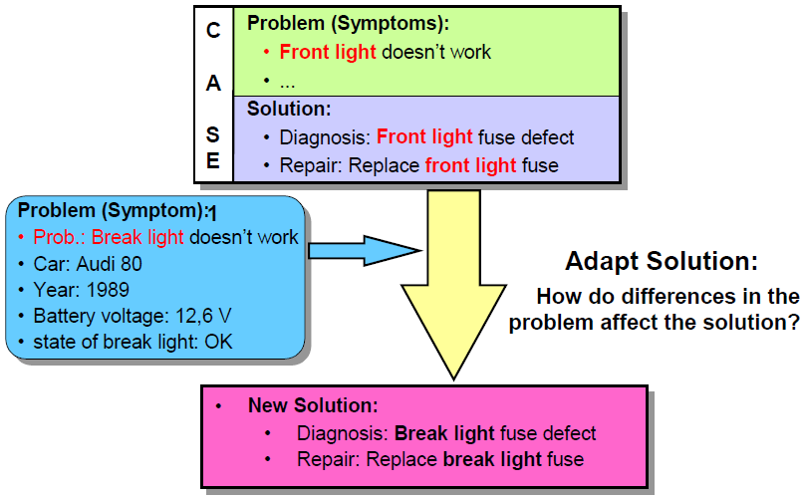
Example Case-Car diagnostic (Conti…)
REUSE the solution of CASE 1
Source: https://courses.csail.mit.edu/6.871/lectures06/Lect17CBR.pdf
35

Slide 36
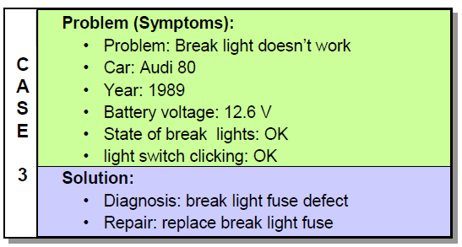
Example Case-Car diagnostic (Conti…)
RETAIN the new solution
If the diagnosis is correct: Store it to the case-base
Source: https://courses.csail.mit.edu/6.871/lectures06/Lect17CBR.pdf
36

Slide 37
CONCLUSION
CBR is a technique that solve problem based on previous experience
CBR involve four cycles: retrieve, reuse, revise, retain
Use weightage to measure similarity between cases
37

Slide 38
REFERENCES
References
Aamodt A, Plaza E (1994) Case-based reasoning: foundational issues, methodological variations, and system approaches. AI Communications 7 (1):39–59
Russell, S.J. & Norvig, P. (2020), Artificial Intelligence: A Modern Approach 4th edition. New Jersey: Pearson Education Inc (0134610997)
Charu C. Aggarwal (2021), Artificial Intelligence: A Textbook. Berlin/Heidelberg: Springer (3030723569)
Laurence Moroney (2020) AI and Machine Learning for Coders: A Programmer's Guide to Artificial Intelligence 1st Edition. California: O'Reilly Media (1492078190)
Richard E. Neapolitan (2020), Artificial Intelligence 2nd Edition Oxfordshire: Routledge (0367571641)
38

